Slide 1
To Fail or Not To Fail?
Identifying liquidity risks and future bank failures
Group 1: The Random Forests
Members: Dane Kunkel, Brandon Anderson, Sreya Nalla
Notes:
Entered text
## General Information
In the current financial market, banks are making riskier and riskier strategic moves to stay competitive. In doing so, they open themselves up to higher levels of risk compared to normal practice procedures.
When looking at specific ratios to indicate a banks “riskiness” rating: S/A (securities to assets), C/A (cash to assets), and L/D (loans to total_deposits), in addition to quarterly percent change (increase or decrease) of cash, assets, securities, loans, & deposits, you may be able to predict a risky banks chance of failure.
After identifying a risky bank that is potentially a risk for failure, you are able to change your investment position and company holdings in specific banks to ensure risk mitigation.
We mainly considered the size of our data and the complexity of the problem when determining which type of model to use.
We planned on predicting bank failures based on financial metrics like cash, assets, loans, deposits, etc., and decided a more advanced model would be better suited than a simple linear regression model given the complexity of the problem. Specifically, we compared linear regression, logistic regression and neural network models.
Linear regression proved to be the simplest model, but has several limitations when it comes to our high priority needs. Logistic regression and neural networks offered us more flexibility and could handle a wider range of tasks. Ultimately, neural networks seemed the most appropriate for our training dataset and output requirements.
### Data preparation
1. Drop null values & standardize data types (i.e., convert to floats & date type)
2. Calculate critical metrics
* Securities to Assets (S/A) Ratio
* Cash to Assets (C/A) Ratio
* Loans to Deposits (L/D) Ratio
* Percent change quarter over quarter (QoQ)
3. Drop unwanted rows/columns - For each of the banks in our dataset, we removed
* Nulls. In our case, this resulted in removing the first quarter’s worth (dated “2019-03-31”) of data for each bank
* The last quarter’s worth (dated “2023-06-30”) of data so we could use it to predict risk once we had an established model
For critical metrics, we grouped the data for each bank by quarter in order to determine QoQ change and establish a threshold for “riskiness”. Specifically, a bank had a “risky” quarter if it met the following criteria:
* S/A Ratio >= 0.20 (20%) and
* C/A Ratio <= 0.05 (5%) and
* L/D Ratio >= 0.70 (70%)
Entered text
As seen in the box plot below, the average for securities to asset ratio falls around 20%, with outliers holding securities above 70% of total assets. Based on our model, we can infer that these banks are overexposed to securities. In the event the securities depreciate, the bank would be a high risk target. Similarly, banks with low cash to asset ratios would experience similar concerns. The average is around 5%, but there are some outliers that are holding between 25-98% cash. Most banks that could be considered risky hold a loan to deposit ratio around 75%, but there are some outliers holding above 100% and close to 0%.
When training the model, we attempted to identify a relationship between asset volume and calculated ratio levels (S/A, C/A , L/D) change QoQ to potential bank riskiness.
When testing the model initially, we were faced with “Not a number” loss and loss greater than 1, which indicated we experienced a data leak issue. This caused us to remove the S/A, C/A, and L/D ratios as those numeric values were utilized to identify our training bank data.
We tested different types of input data: percentage change, versus ratios, versus volume. We decided the most optimal dataset would include volume and percent change of the volume metrics QoQ as this data is easily available via download and does not need additional manipulation.
When reviewing the data, there were large spreads between the volume of assets between large banks and small banks. In addition, the percent change values were all very small compared to the volume metrics. Standard Scaler did not produce strong results in our model, which caused us to search for alternative options. We identified Normalizer to use as we were dealing with large discrepant data sets and values that were positive and negative.
After selecting and fixing data, we applied a dropout as the original model had very low accuracy (below 60%). We tested different levels of dropouts and discovered a 20% dropout yielded the strongest results compared to 15% and 30%.
In this model, we see poor recall at 66% meaning there were many false positives.
In this optimization, we see recall increase to 100% for the Risky classification but the Non-Risky classification recall drops to 82% and the Risky precision falls to 30%, showing many false positives were predicted.
Entered text
In optimization #3, we see recall fall to 3%, making this model very bad at predicting risky banks.
Finally, to improve the model, we increased the number of epochs from 20 to 50 to improve our model even further. This improved our model's recall to 0.77, while maintaining accuracy, f1-scores, and precision.
After a few rounds of optimization, we were able to generate a relatively strong model that could predict risky banks at a 96% accuracy. When applying a new data set we had for Q2’23, we were able to predict banks that were risky based on QoQ changes, current asset volumes, and indicator ratio combinations.
When running the predictions, we identified 15% of banks that could be considered high risk banks, primed for failure.
Risky = 697
Non-risky = 3823
## Use Cases
1. Predict upcoming bank failures for market indicators or revenue opportunities
2. Determine banks that may be considered risky for short selling
3. Determine banks that are worth investment or working with when selecting a finance partner or cash storage option
## What if we had more time...?
1. Continue to test new model optimizations to improve accuracy, recall, and precision of the model
2. Build in a dynamic dashboard to evaluate banks and showcase risky banks in visual formats
3. Build a dashboard that can automatically update based on new data uploads and is searchable for product use

Slide 2


Slide 3
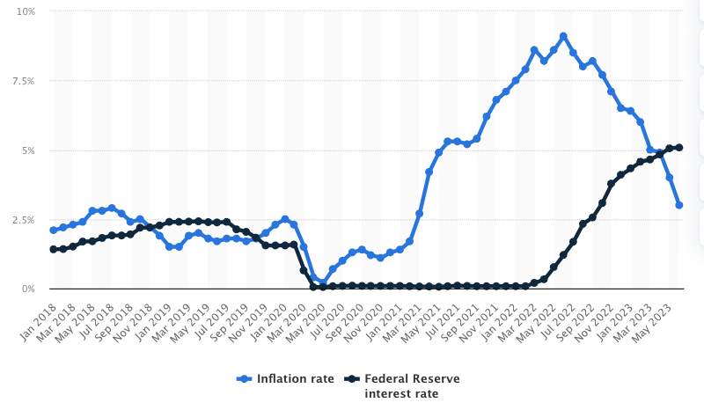
Overview
Why did we choose this project?
Given recent regional bank turmoil and the collapse of Silicon Valley Bank (SVB), First Republic, and Signature, there is a spotlight from the FDIC, regulators, and the public on the financial condition of banks
The macro interest rate environment has led to quantitative tightening. Money is more expensive for banks as rates have gone up. As a result, this has led to low cash positions, securities depreciation, and riskier lending practices to stay competitive. In doing so, banks open themselves up to higher levels of risk compared normal market cycles.
Goal
Analyze recent quarterly bank data and determine if we can predict bank is risky or not. In order to do this, the team trained a machine learning model.
After identifying a risky bank, an investor or depositor might seek to change their relationship with the bank from a trading or personal perspective

Slide 4
Data & Metrics
We used BankRegData to create a cohesive quarter or quarter dataset of all banks between 2019 and 2023. We picked this time period because over $800B of stimulus money entered the banking system during COVID and banks are starting to feel the rippling impact of these deposits and their decisions.
Securities / Assets: The proportion of a bank’s securities to its total assets
Cash / Assets: The proportion of a bank’s cash to its total assets
Quarterly Percent Change: Increase or decrease of total cash, assets, securities, loans, & deposits.
Loans / Deposits: For every dollar that a bank takes in as a deposit, the ratio of those dollars to the loans they originate

Slide 5
Data Preparation
Standard Data Cleaning
Drop nulls & Standardize data types
Calculate critical metrics
S/A Ratio
C/A Ratio
L/D Ratio
Percent change QoQ
Preserve Data
Save Q2’23 data to use for final predictions
Refine Data
Drop unwanted columns (nulls, Q1’19)

Slide 6
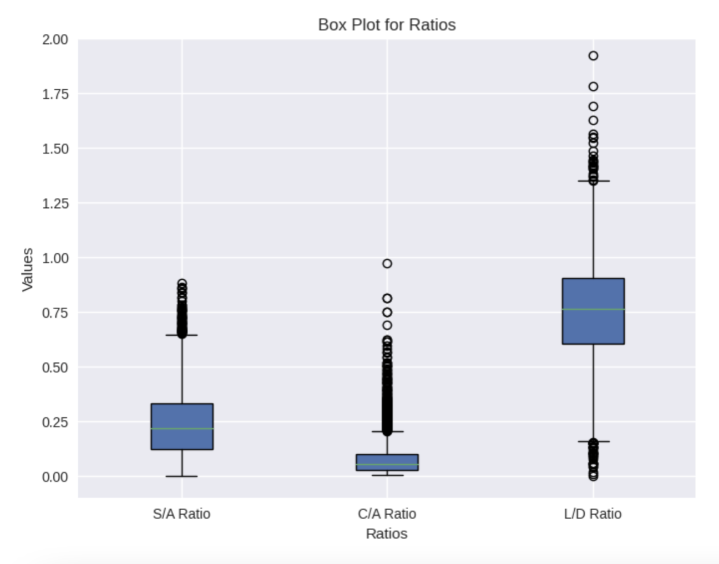
Critical Metrics
A bank had a “risky” quarter if it met all of the following criteria:
S/A Ratio >= 0.20 (20%)
C/A Ratio <= 0.05 (5%)
L/D Ratio >= 0.70 (70%)
Notes:
We grouped the data for each bank by quarter in order to determine QoQ change and establish a threshold for “riskiness”.

Slide 7
Choosing a Model
 | Linear Regression | Logistic Regression | Neural Network | Priority
Purpose | Regression | Binary Classification | Both | High
Complexity | Simple | Moderate | Complex | Medium
Data Size | Small/Medium | Small/Medium | Large | High
Applicability | Linear Relationships | Binary Classification | Versatile (good for both!) | High
Risk of Overfitting | Low | Moderate | High | High
Computational Resources Used | Low | Low/Moderate | High | Low
Notes:
Linear regression proved to be the simplest model, but has several limitations when it comes to our high priority needs. Logistic regression and neural networks offered us more flexibility and could handle a wider range of tasks. Ultimately, neural networks seemed the most appropriate for our training dataset and output requirements.

Slide 8
Dealing with a Model That Wouldn’t Train
We encountered 'Not a number' and loss greater than 1 when attempting to train our data, which led us to realize there is a data leak in our model
We tested different types of input data: Percentage change, Ratios, & Volume
We selected volume and percent change of volume metrics QoQ after removing S/A, C/A, and L/D ratios due to data leak
This data is easily available via download, with no additional manipulation needed
This enabled us to start training the model effectively and begin optimizations to improve performance
Our model netted a 1.66% loss and 99.4% accuracy
StandardScaler was not effective, so we searched for alternatives and landed on Normalizer as there were large spreads between asset volume of large and small banks and the inclusion of percent change data

Slide 9
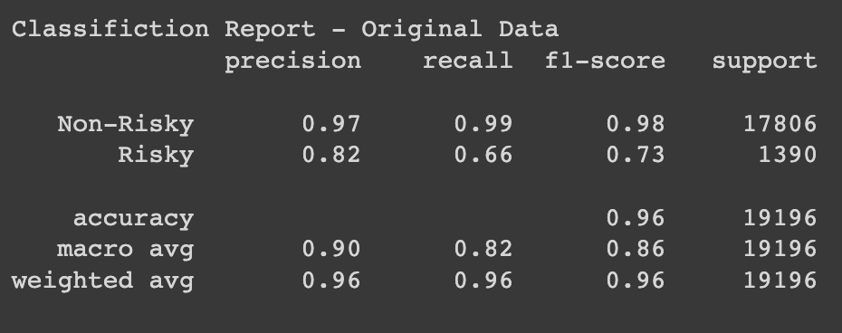
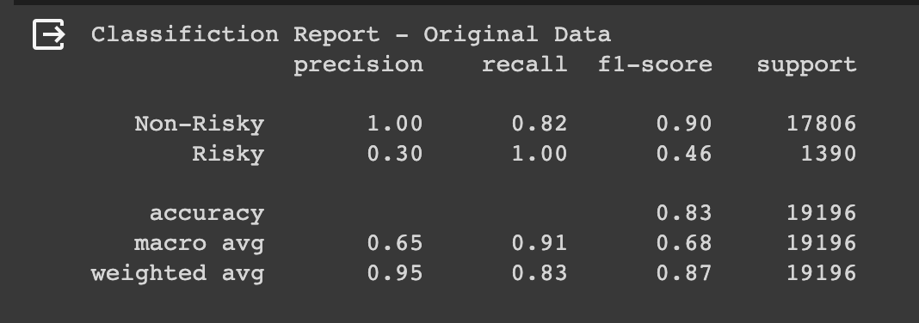
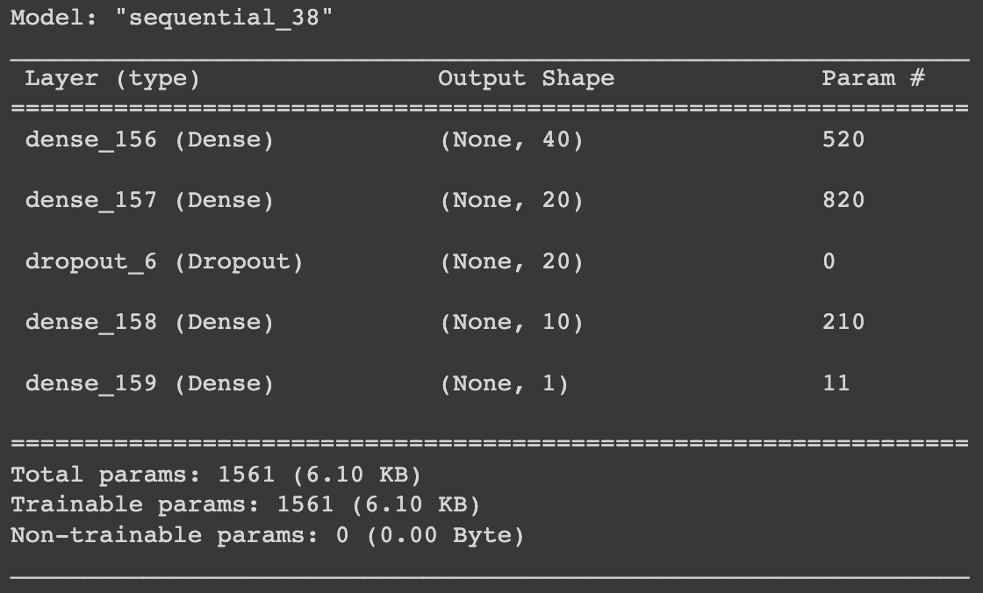
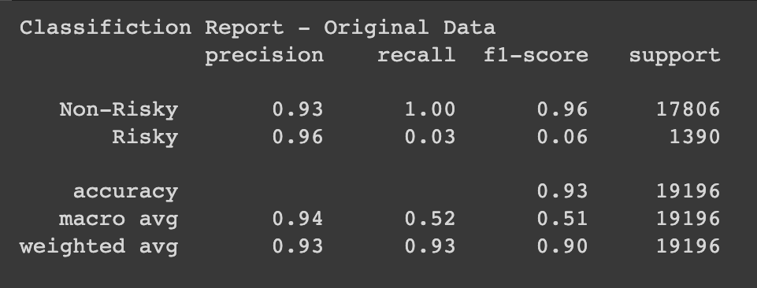
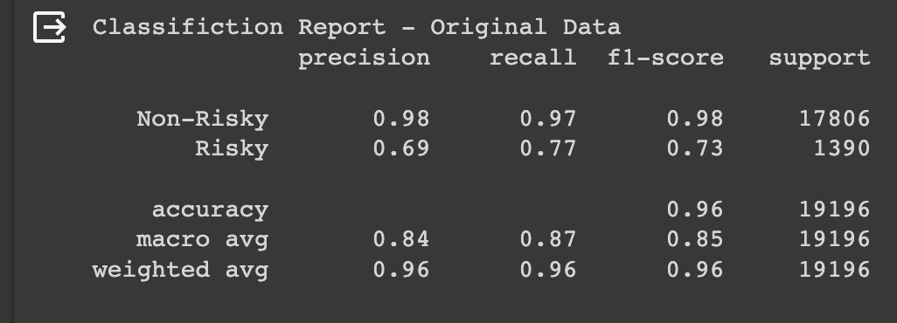
Model Optimization
Altered seed data to ensure no data leak and trained the model on optimal scaled data
1
Applied a dropout to improve model accuracy, tested different levels, and discovered 20% yielded strongest results
2
Increased number of epochs for stronger model accuracy and minimal loss
3
4

Slide 10
Evaluation Results
Risky classification Recall increases to 77%, up from 66%
Model Accuracy remains strong at 96% prediction
f-1 scores all above 70% showcasing positive predictions are correct a majority of the time
Non-Risky classification remains strong with 98% precision and 97% recall

Slide 11
Applying model to recent data to
predict bank “riskiness” in Q2’23

Slide 12
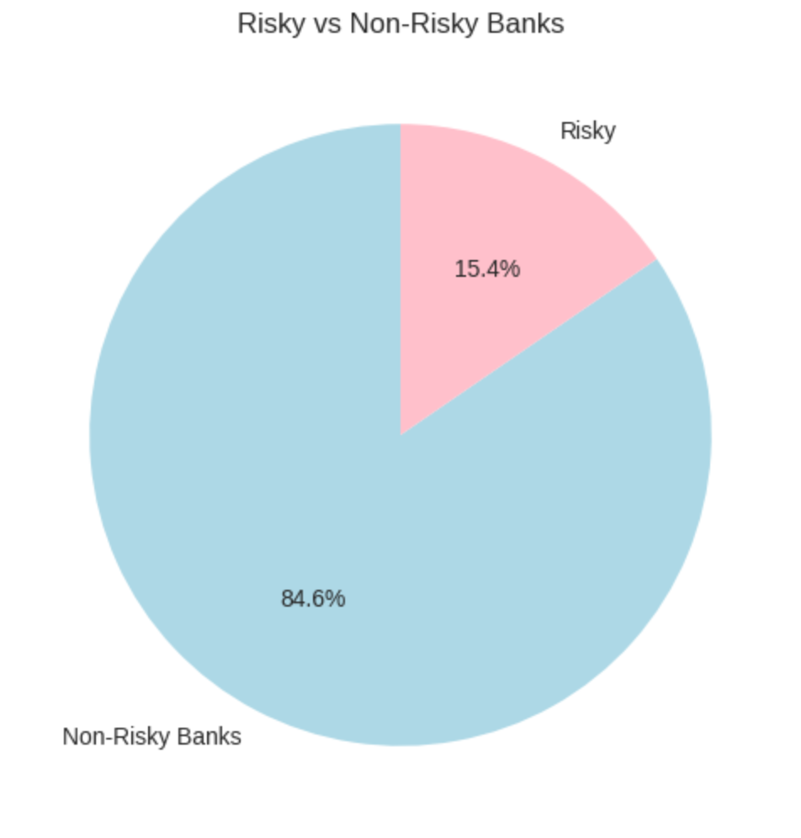
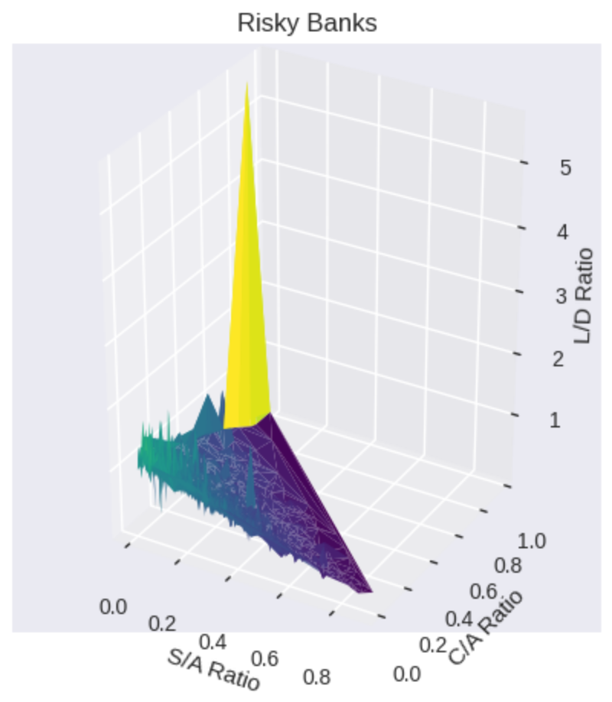
Findings
15.4% of banks deemed risky for Q2 2023. This is 697 risky banks!
Commercial Bank & Trust Company
Bank of Cave City
Bank of Madison
Exchange Bank
Tri-County Bank & Trust Company
Solon State Bank
Stock Yards Bank & Trust Company
Kentucky Farmers Bank
Morgantown Bank & Trust Company
Community Financial Services Bank

Slide 13

Use Cases
Predict upcoming liquidity issues and bank failures
Determine banks that may be considered risky for short selling
Determine which banks are "safe" to invest in, work with, or deposit money in

Slide 14
Future Plans
Test new model optimizations for improved accuracy, recall, and precision
Create a trading algorithm that trades on safe and risky banks based on the ratios and metrics
Create searchable dashboard for automatic updates based on new data uploads
Build dynamic dashboard for bank evaluation and visualization of risky banks

Slide 15


Slide 16
Q&A

Slide 17
Appendix
Github Repository
BankRegData (data source)
Model Output & Results

